Slide 1
Lab #2 Pully
Authors: Hannah Bishop and Justis Findley

Slide 2
Introduction
The overall purpose of this lab was to 3D print a pulley assembly.
This assembly would be tested to discover the best weight-to-load ratio it could withstand.
This lab’s main goal was for us students to be able to practice additive manufacturing and to work on our own design.

Slide 3
Equipment
Inventor Software
Fuson 360
Bamboo lab studio
Bamboo lab X-1 Carbon
Crain Scale
Rope
Slow-motion Camera

Slide 4
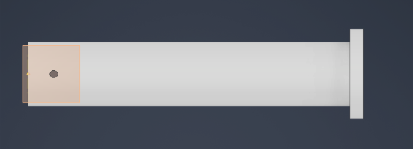
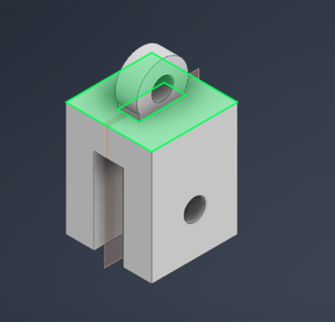
Design
The x-axis was used to start the 2-D sketch when designing the U-assembly. The basic shape was made on the X-plane and made to be shaped like a U. After finishing the 2-D shape, we moved to the 3-D space using the extrude. On top of the U-shape, a second 2-D sketch was started. A circle was added to fix the U shape. For the last 2D sketch, a smaller circle was cut through the object. Two more were added so that a pin could slide through the open space in the assembly.
A pin was made by starting a 2D sketch, adding a hole, and cutting the material all the way through to fit a small pin through. A slightly bigger circle was added to the end.

Slide 5
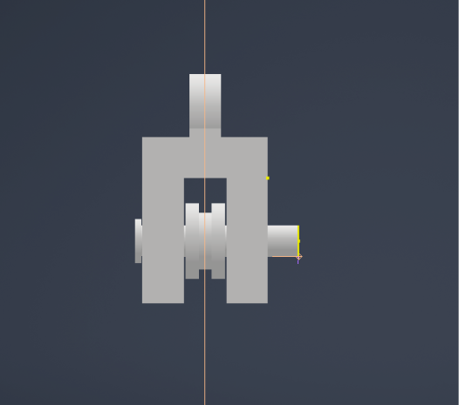
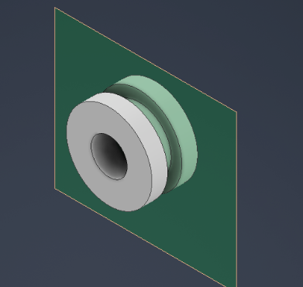
The wheel started with a circle and was then extended. A circle for the pin was added, cutting fully through the object. A circle was added halfway through the wheel and cut on both sides for a notch.
The pulley assembly was made by placing the U-assembly and constraining the pinto the holes on the U-assembly. Then, the wheel was constrained to the pin by the middle hole.

Slide 6
Procedure: Printing
Different versions (V4–V10) were printed with varying infill, walls, and layer settings. Adjustments included nozzle size (0.6 mm) and patterns like rectilinear, concentric, and Hilbert Curve. Scaling (50–75%) was tested to assess performance and tolerance.

Slide 7
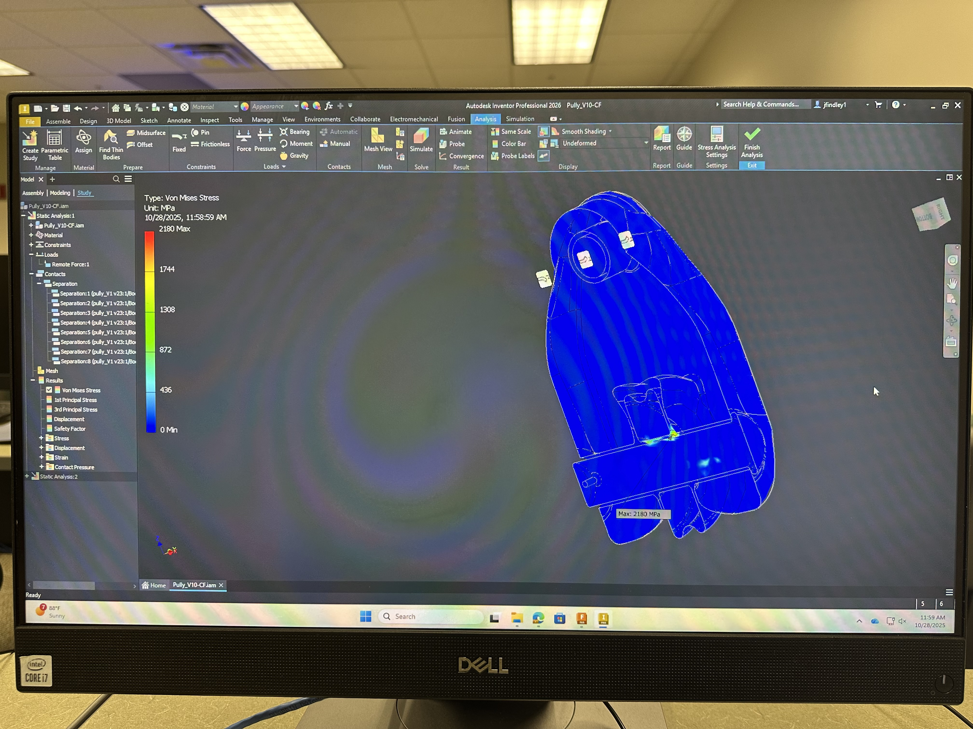
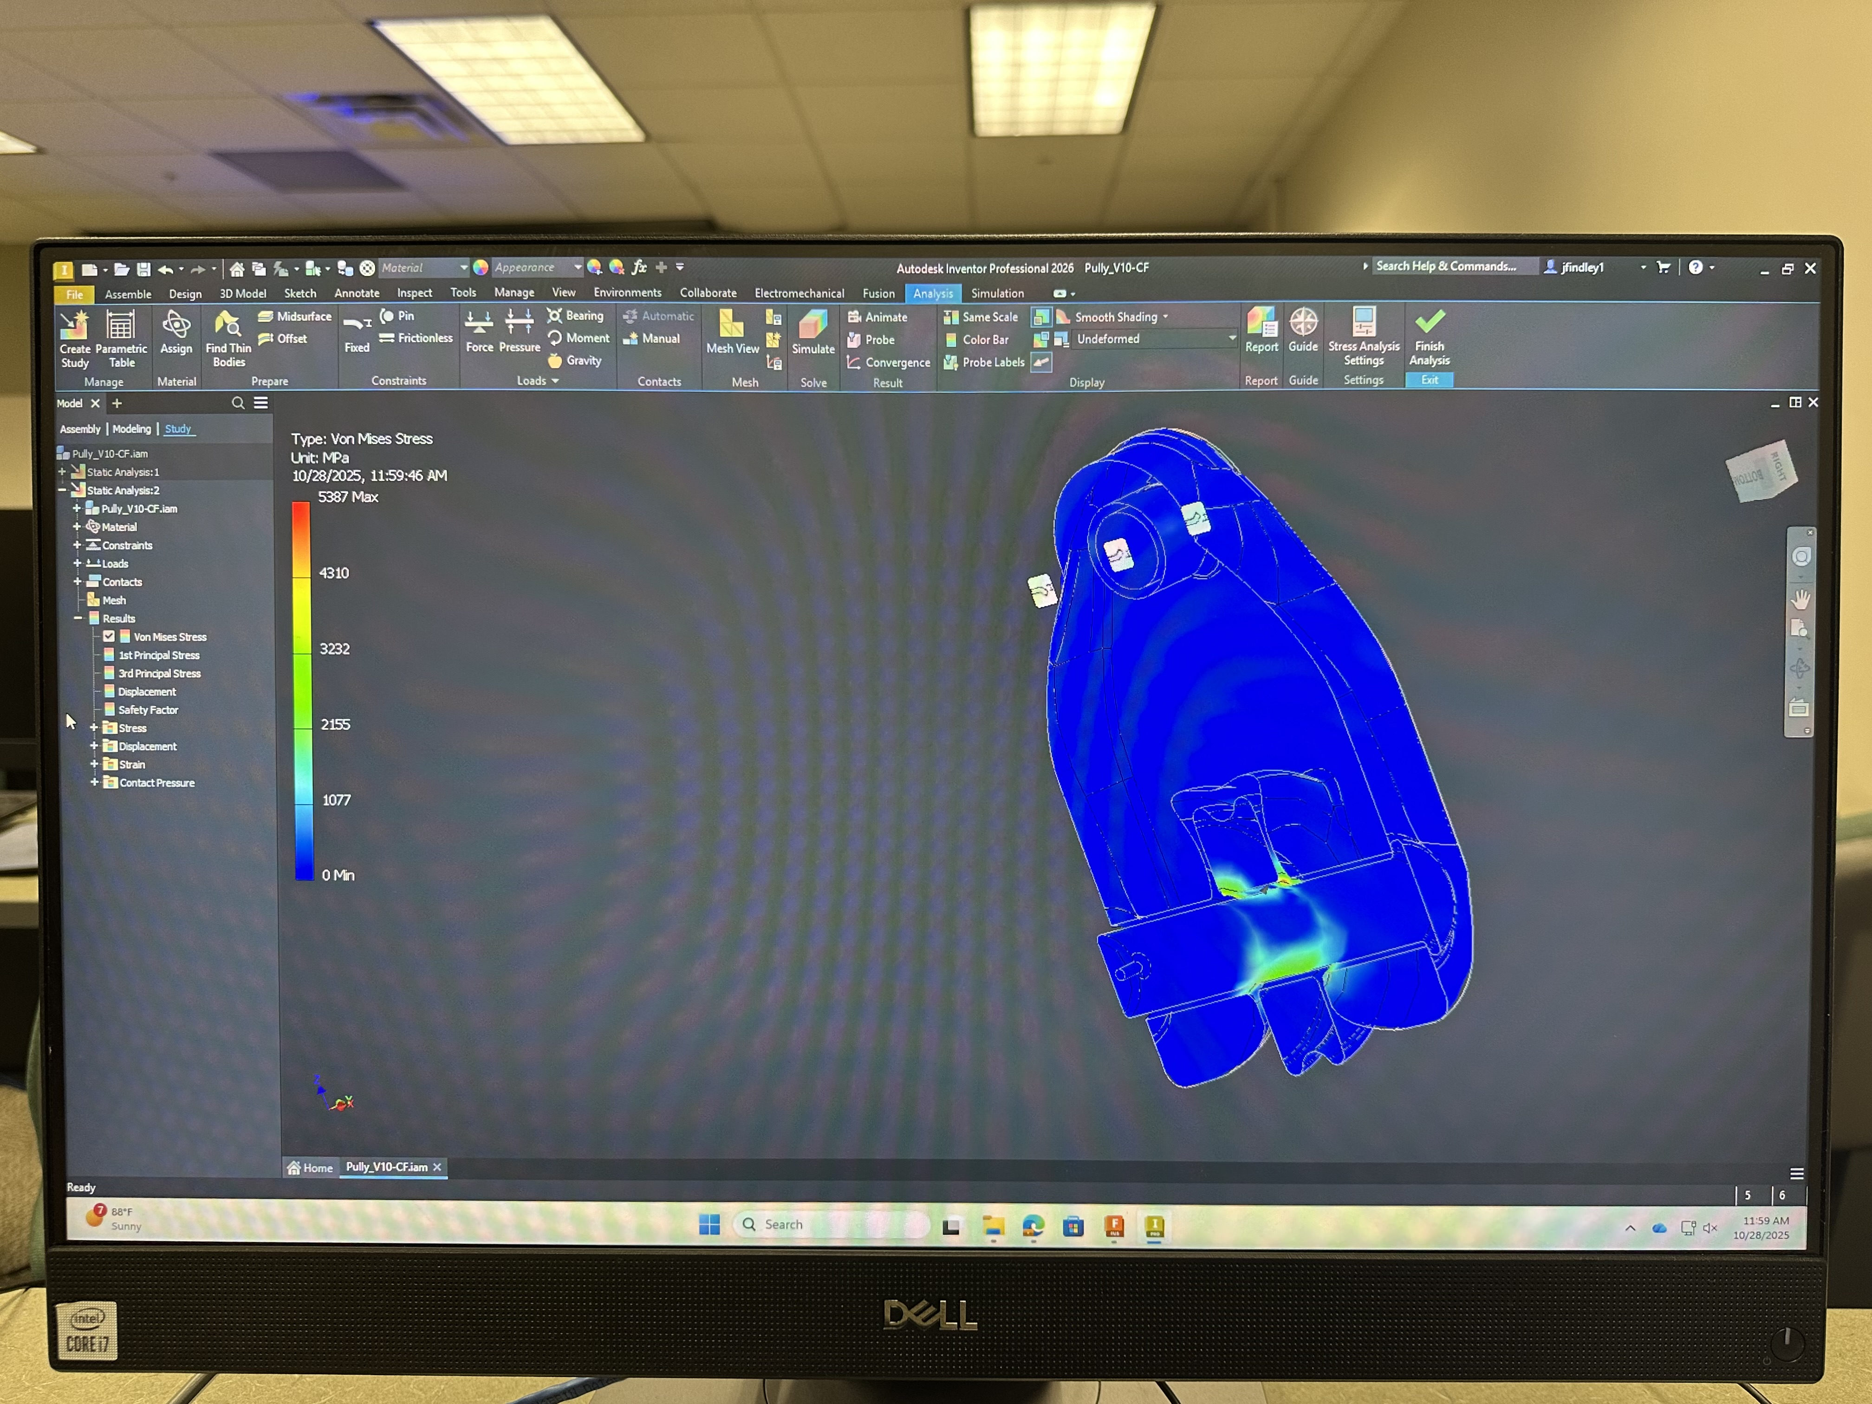
FEA
Several tests were done however when using Inventor, the final design showed minimum stress with a load of 1000 LB.

Slide 8
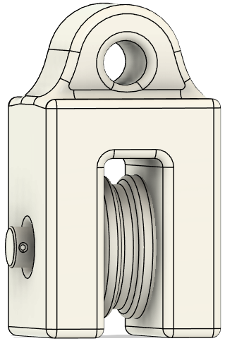
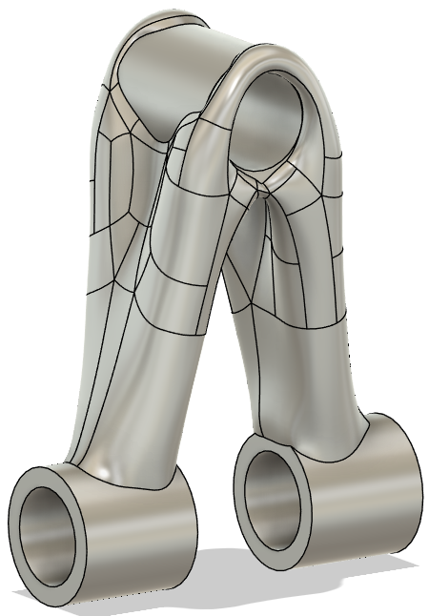
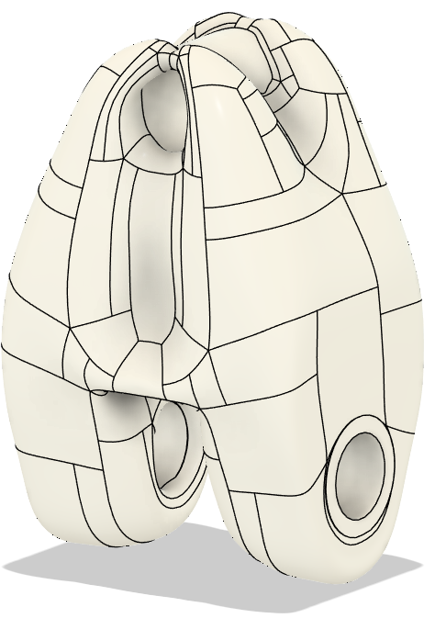
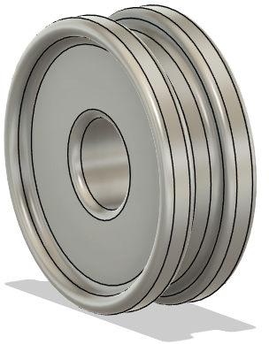
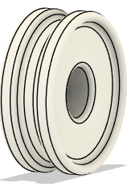
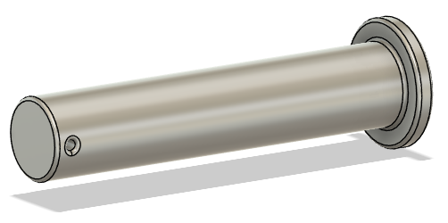
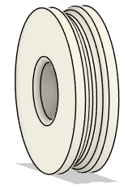
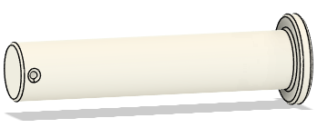
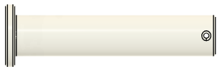
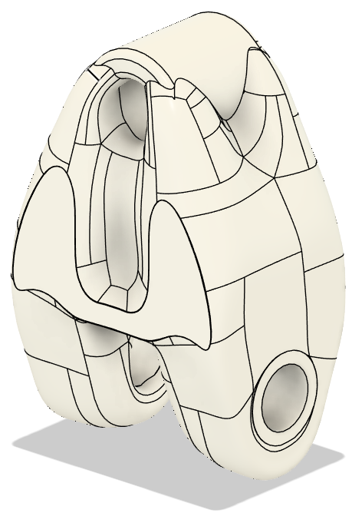
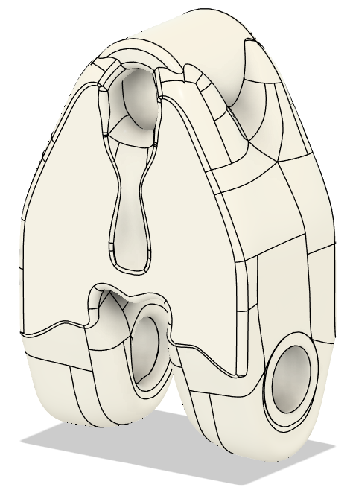
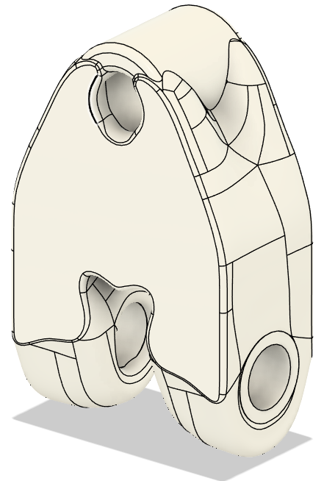
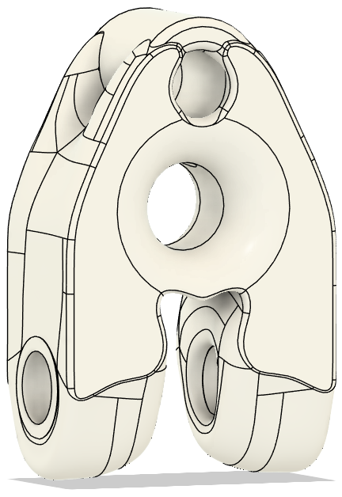
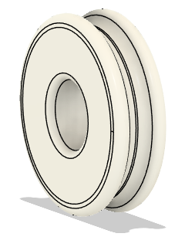
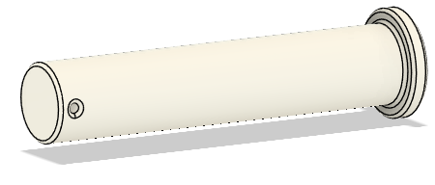
Data
V1
V2
V4
The first modified version with a print time of 3 hours and 35 minutes weighed 22.7 grams and only healed ~50 LB and broke at the pin support for a ratio of 2.2.
V4 with a print time of 7 hours and 47 minutes weighed 78.6 grams and healed ~606 LB and broke at the top hole for a ratio of 7.7.
V5 with a print time of 6 hours and 23 minutes weighed 63.4 grams and healed ~608 LB and broke at the top hole for a ratio of 9.59.
V6 with a print time of 5 hours and 45 minutes weighed 51.9 grams and healed ~397 LB and broke at the pin support for a ratio of 7.65.
V7 with a print time of 4 hours and 41 minutes weighed 48.5 grams and healed ~382 LB and broke at the pin support for a ratio of 7.88.
V7.5 with a print time of 1 hours and 40 minutes weighed 57.3 grams and healed ~664 LB and broke at the pin for a ratio of 11.59.
V8 with a print time of 1 hours and 43 minutes weighed 57.6 grams and healed ~672 LB and broke at the pully for a ratio of 11.67.
V5
V5.5
V7
V8

Slide 9
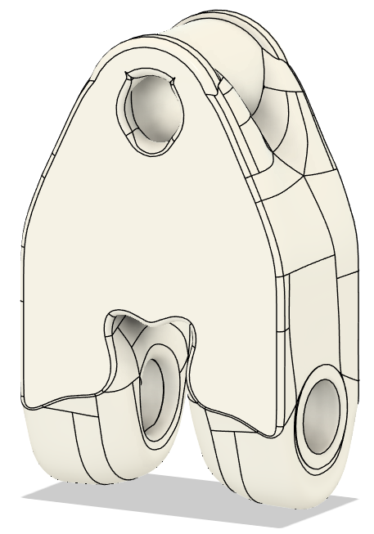
Data
V10 weighed 56.4 grams and healed ~378 LB and broke at the pin support for a ratio of 6.7.
V10-CF weighed 52.6 grams and healed ~794 LB and broke at the pin support for a ratio of 15.1.
V10 (75%) weighed 28.8 grams and healed ~350 LB and did not break for a ratio of 12.15.
V10 (50%) weighed 9.9 grams and healed ~249 LB and broke at the pin support for a ratio of 25.15.
V10-CF (50%) weighed 10.6 grams and healed ~332 LB and broke at the pin support for a ratio of 31.32.
V10-CF (50%) weighed 9.71 grams and healed ~390 LB and broke at the top hole for a ratio of 40.16.
V-10

Slide 10
Data
The best version that was tested was the V10-Cf at 50% scale which achieved a ratio of 40.16 before failure.

Slide 11
Print Settings
11. The Pin for “Housing V7.5” had 4 walls, 4 bottom layers, and 4 top layers with concentric pattern. With a 20% gyroid infill.
12. The next printed version “Housing V8” had 6 walls, 6 bottom layers, and 6 top layers with concentric pattern. It aloes uses 15% gyroid infill.
13. The Pully for “Housing V8” had 3 walls, 3 bottom layers, and 3 top layers with concentric pattern.
14. The Pin for “Housing V8” had 4 walls, 4 bottom layers, and 4 top layers with concentric pattern. With a 20% gyroid infill.
15. New pin V3 were tested with settings 2 walls, 2 bottom layers, and 2 top layers with concentric pattern. One had 5% than 10% and 15% gyroid infill.
16. New pully V4 were tested with settings 2 walls, 2 bottom layers, and 2 top layers with concentric pattern. One had 5% and 10% gyroid infill.
17. The next printed version “V10” had 6 walls, 6 bottom layers, and 6 top layers with concentric pattern. It aloes uses 15% gyroid infill.
18. V10 was also tested at 10 walls, 10 bottom layers, and 10 top layers with concentric pattern.
19. Both V10 versions were also scaled down to 75% and 50%.
20. All V10 prints had tolerance issues when printed with PHAT-CF so new version “V10-CF” only had adjusted tolerances.
21. The next printed version “V10-CF” at 60% scale had 8 walls, 8 bottom layers, and 8 top layers with concentric pattern. It aloes uses 10% gyroid infill.
22. The Pully for “V10-CF” had 4 walls, 4 bottom layers, and 4 top layers with concentric pattern and 15% gyroid infill.
The printer was set up to print with PLA.
The model was set up to print with 2 walls, 3 bottom layers, and 4 top layers with a rectilinear pattern. It also uses 20% gyroid infill.
Note all prints will use auto tree support with a threshold angle of 30 degrees.
The next printed version “V4” had 10 walls, 5 bottom layers, and 5 top layers with rectilinear pattern. It aloes uses 25% gyroid infill.
The next printed version “V5” had 6 walls, 6 bottom layers, and 6 top layers with concentric pattern. It aloes uses 20% gyroid infill.
All versions starting now used 0.6 mm nozzle.
The next printed version “V6” had 5 walls, 4 bottom layers, and 3 top layers with Hilbert Curve pattern. It aloes uses 20% gyroid infill.
The next printed version “V7” had 5 walls, 4 bottom layers, and 3 top layers with concentric pattern. It aloes uses 20% gyroid infill.
The next printed version “Housing V7.5” had 6 walls, 6 bottom layers, and 6 top layers with concentric pattern. It aloes uses 15% gyroid infill.
The Pully for “Housing V7.5” had 3 walls, 3 bottom layers, and 3 top layers with concentric pattern.

Slide 12
Conclusion
We were introduced to new machines and skills vital for any engineer in the workplace.
We practiced using new software and machines that can help us learn about additive manufacturing.
We saw firsthand the importance of thinking through a process, where the design would be the weakest, and the best way to fix those weaknesses.

Slide 13
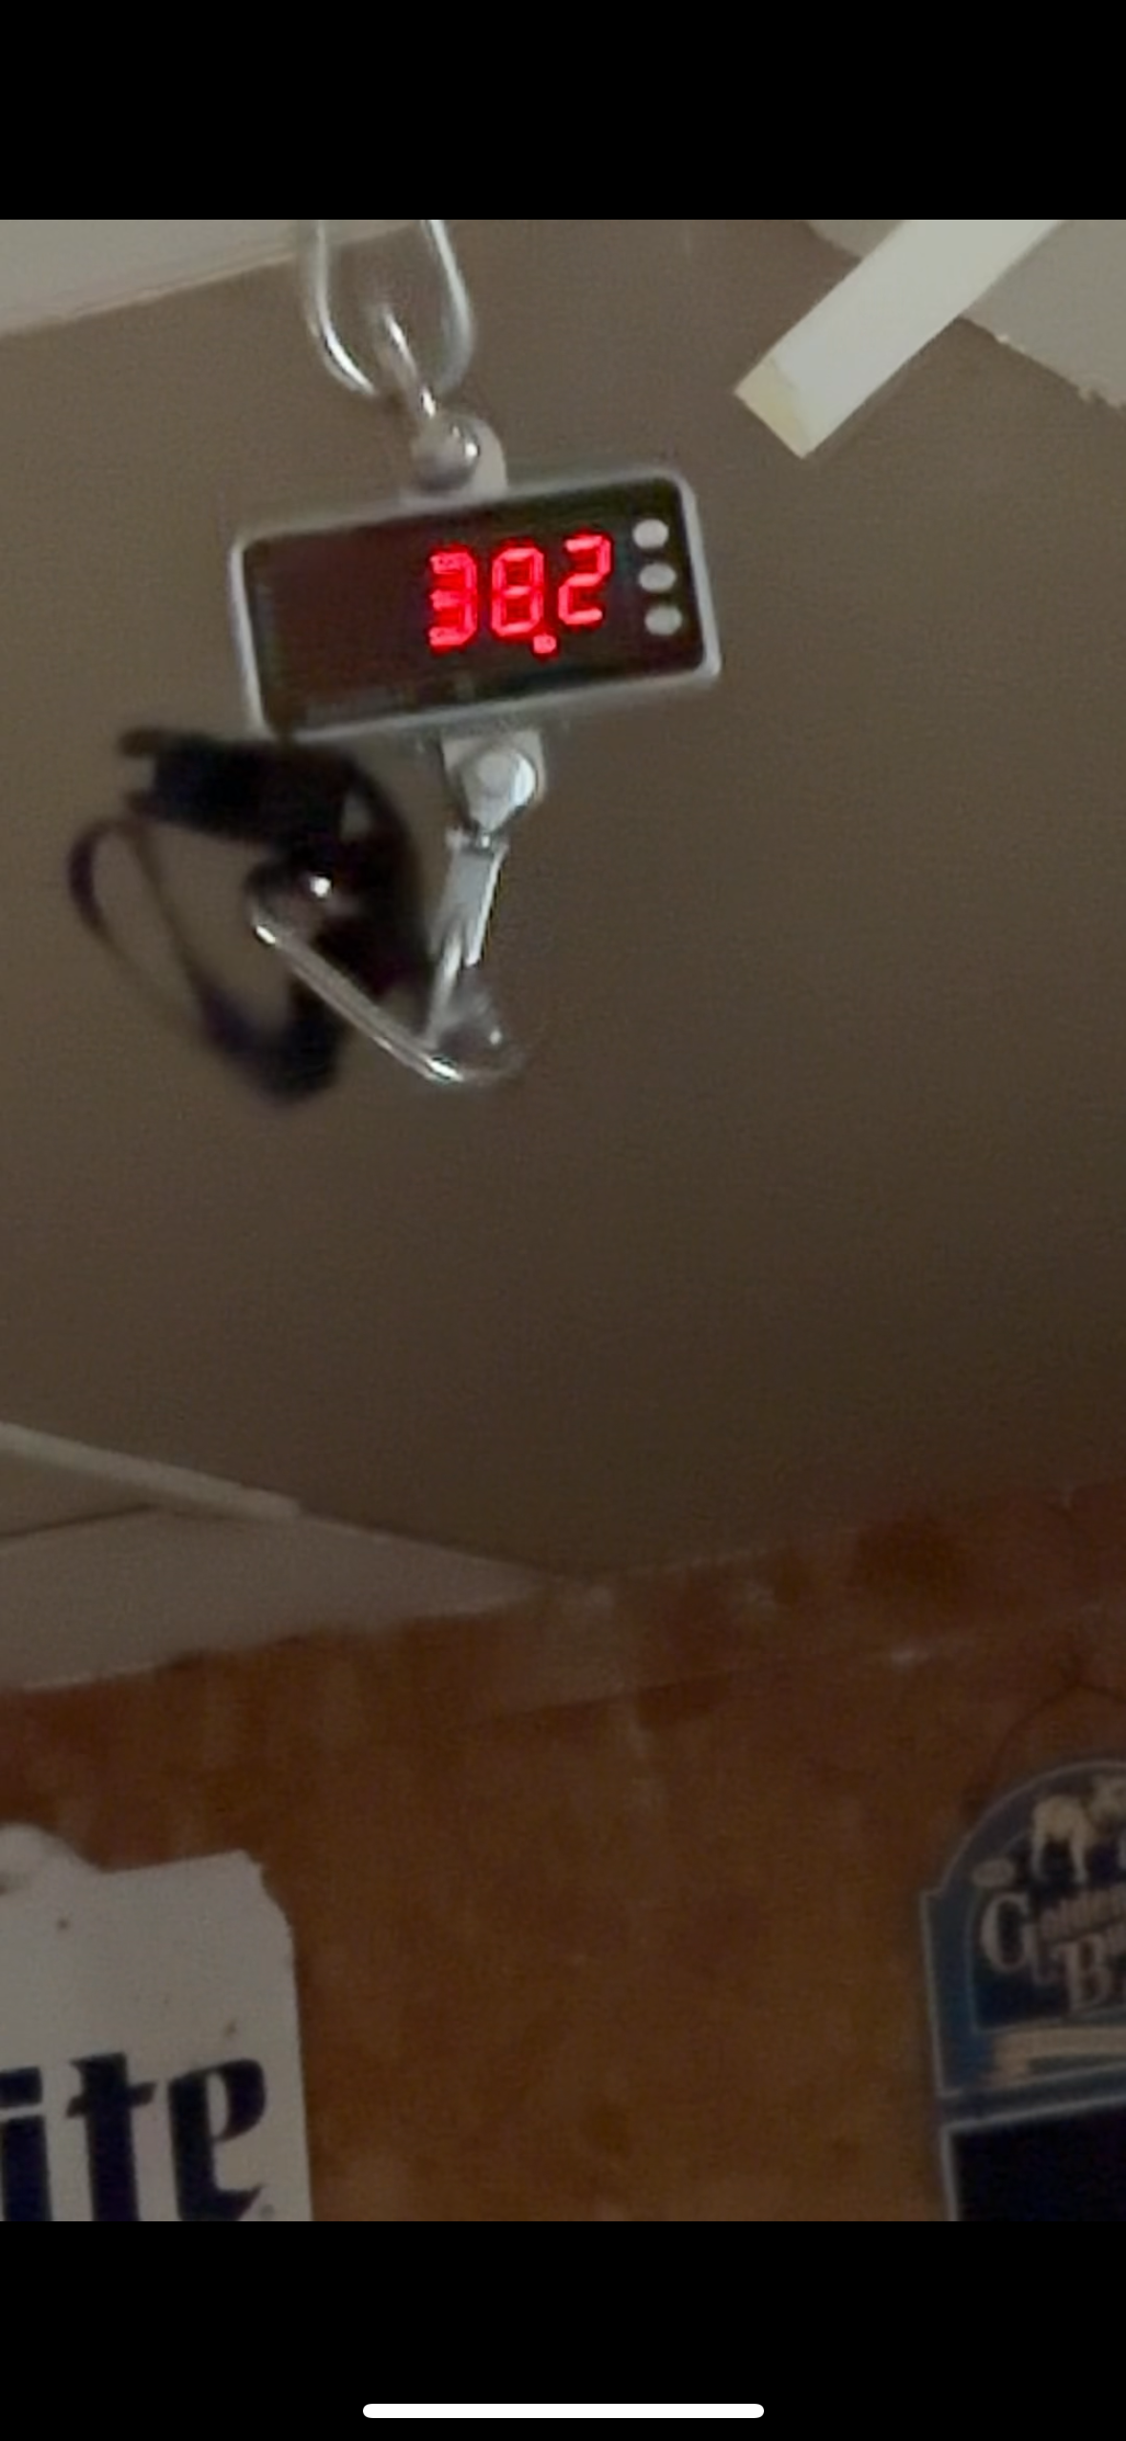
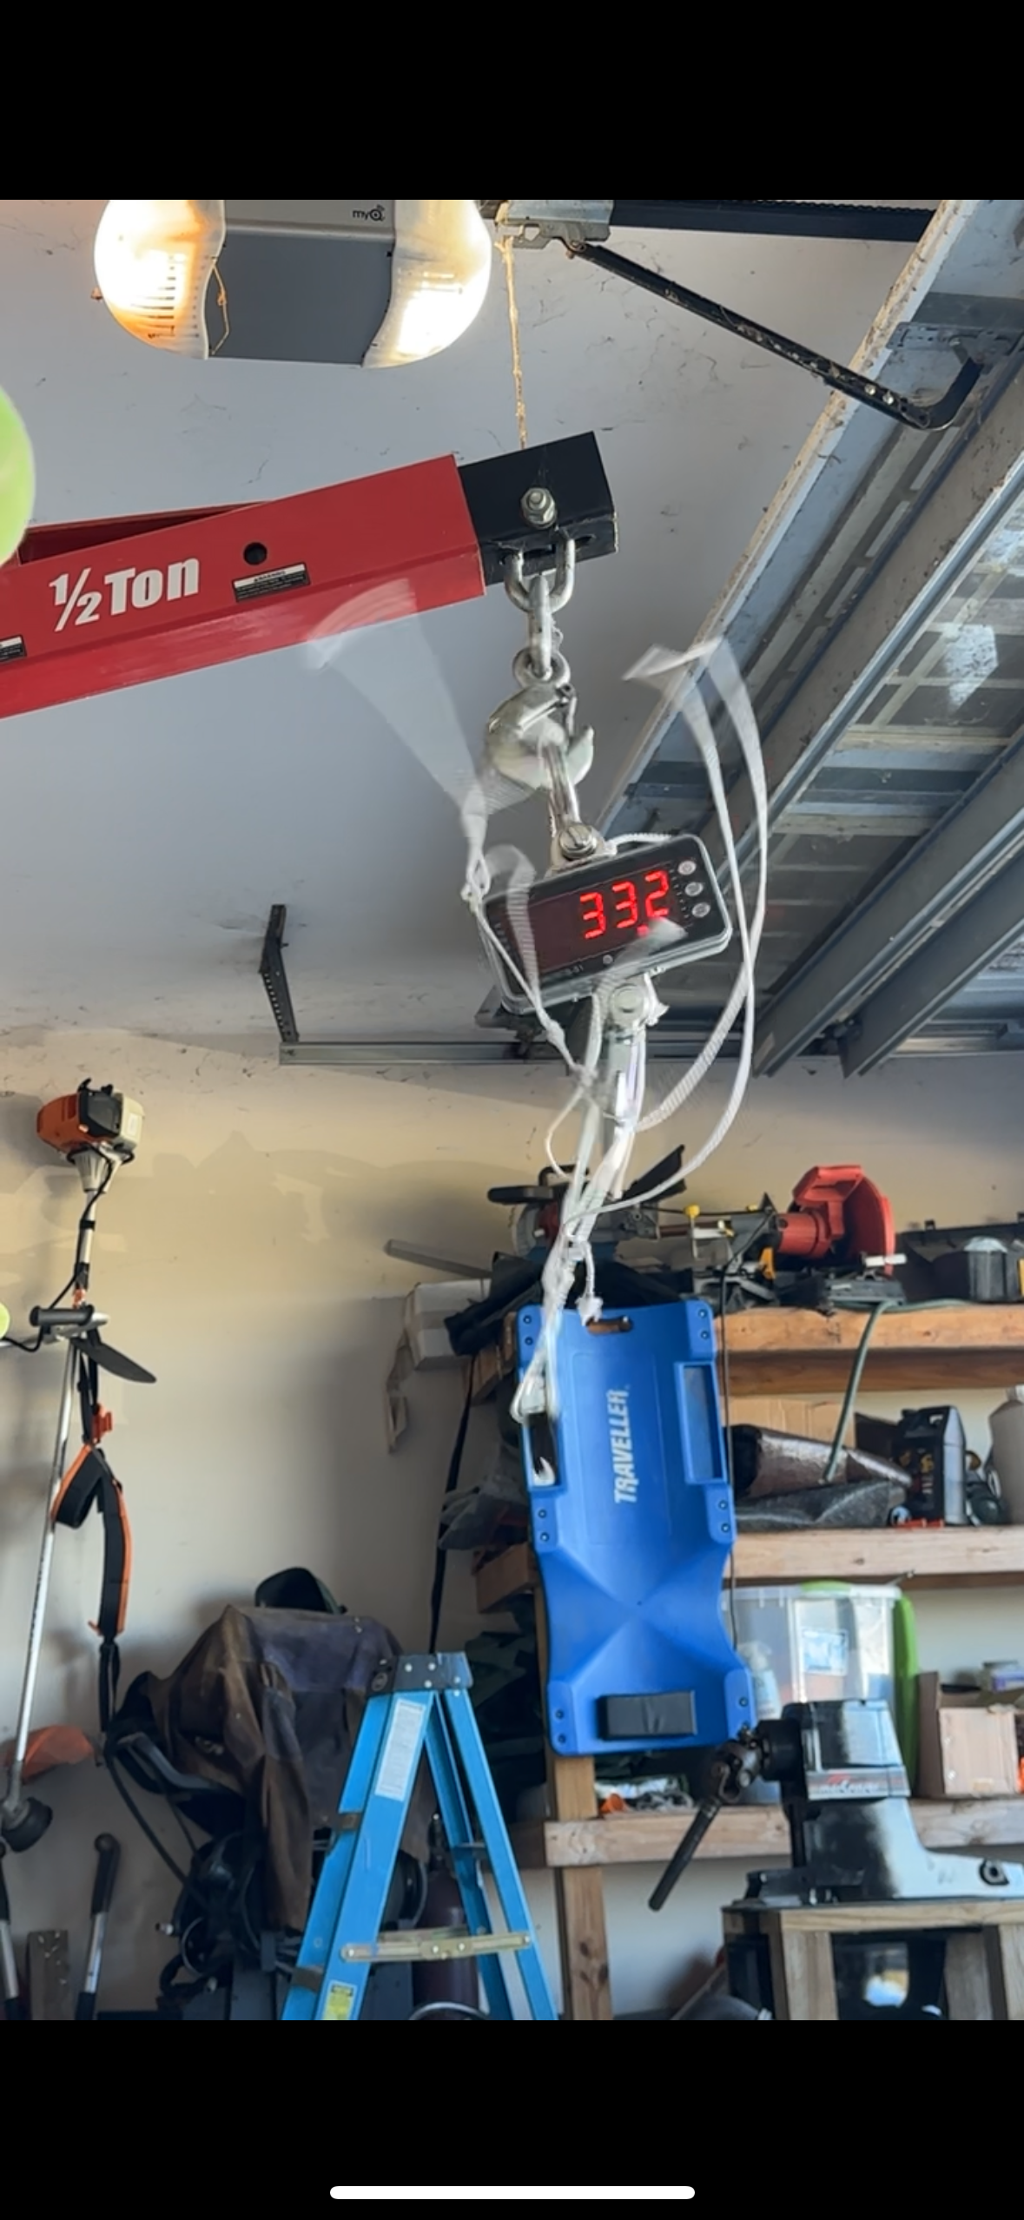
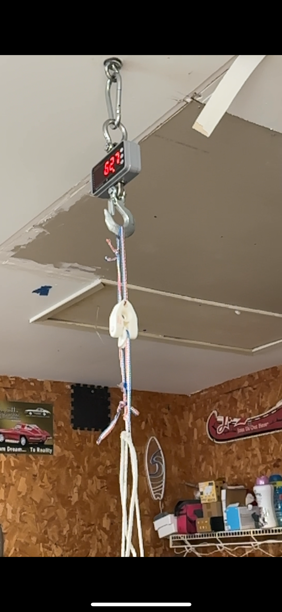
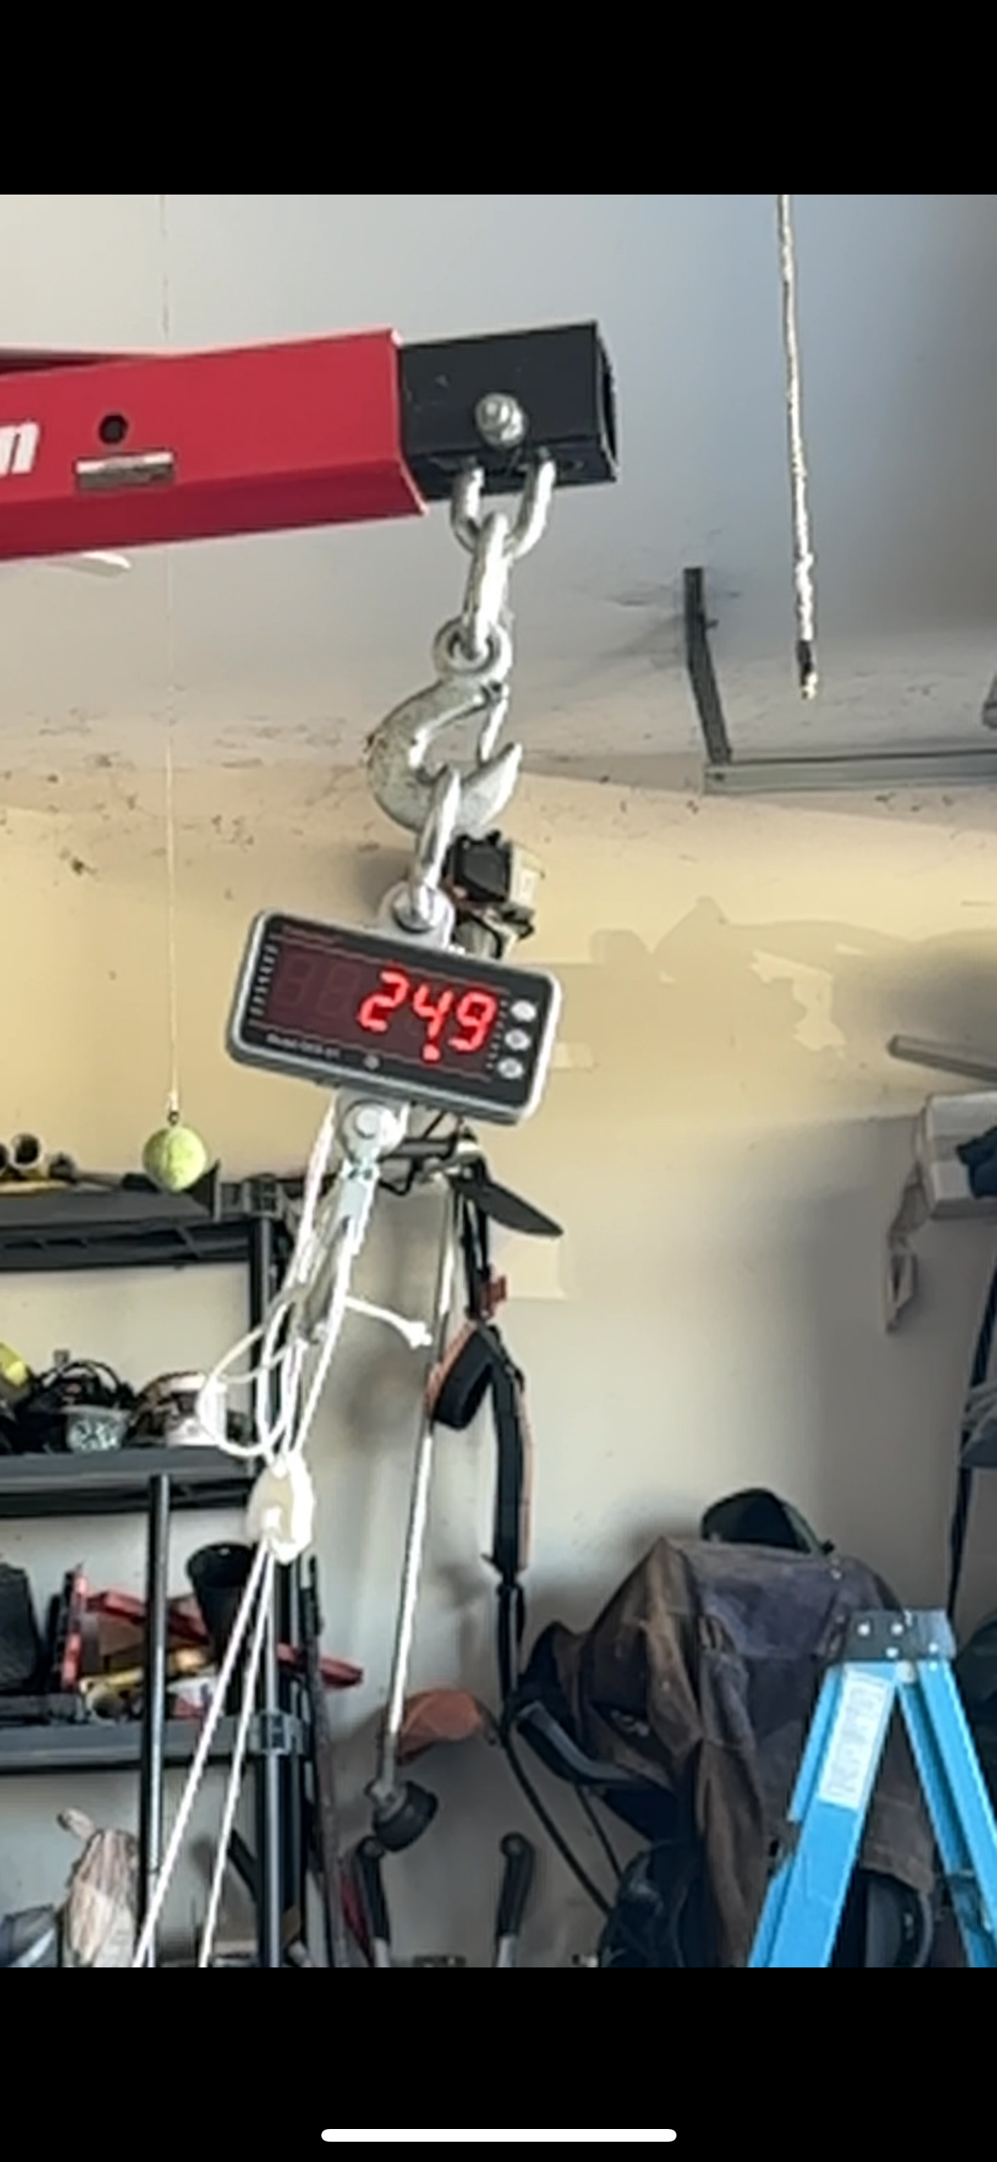
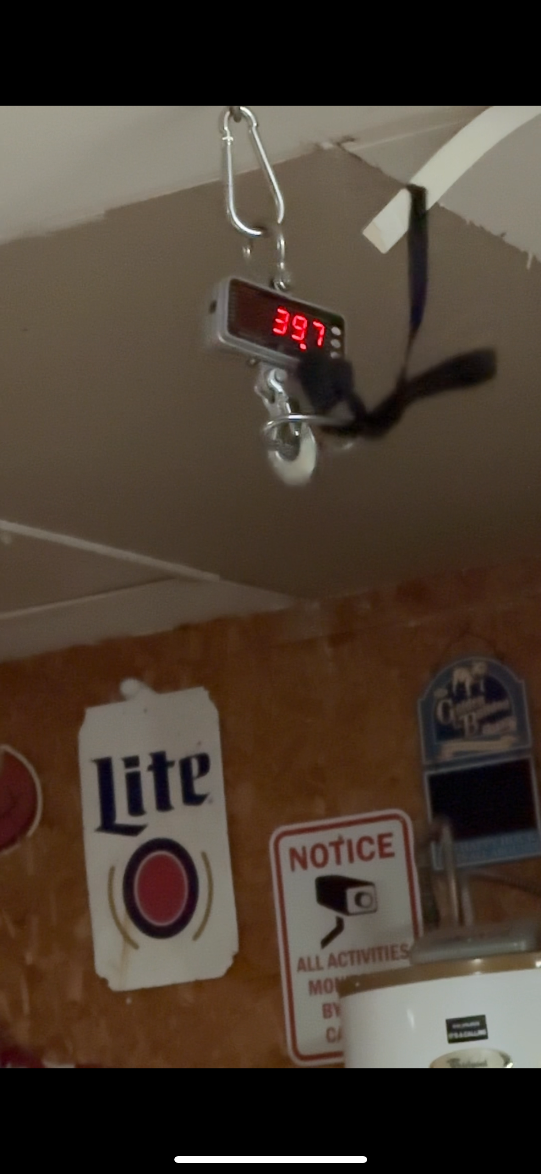
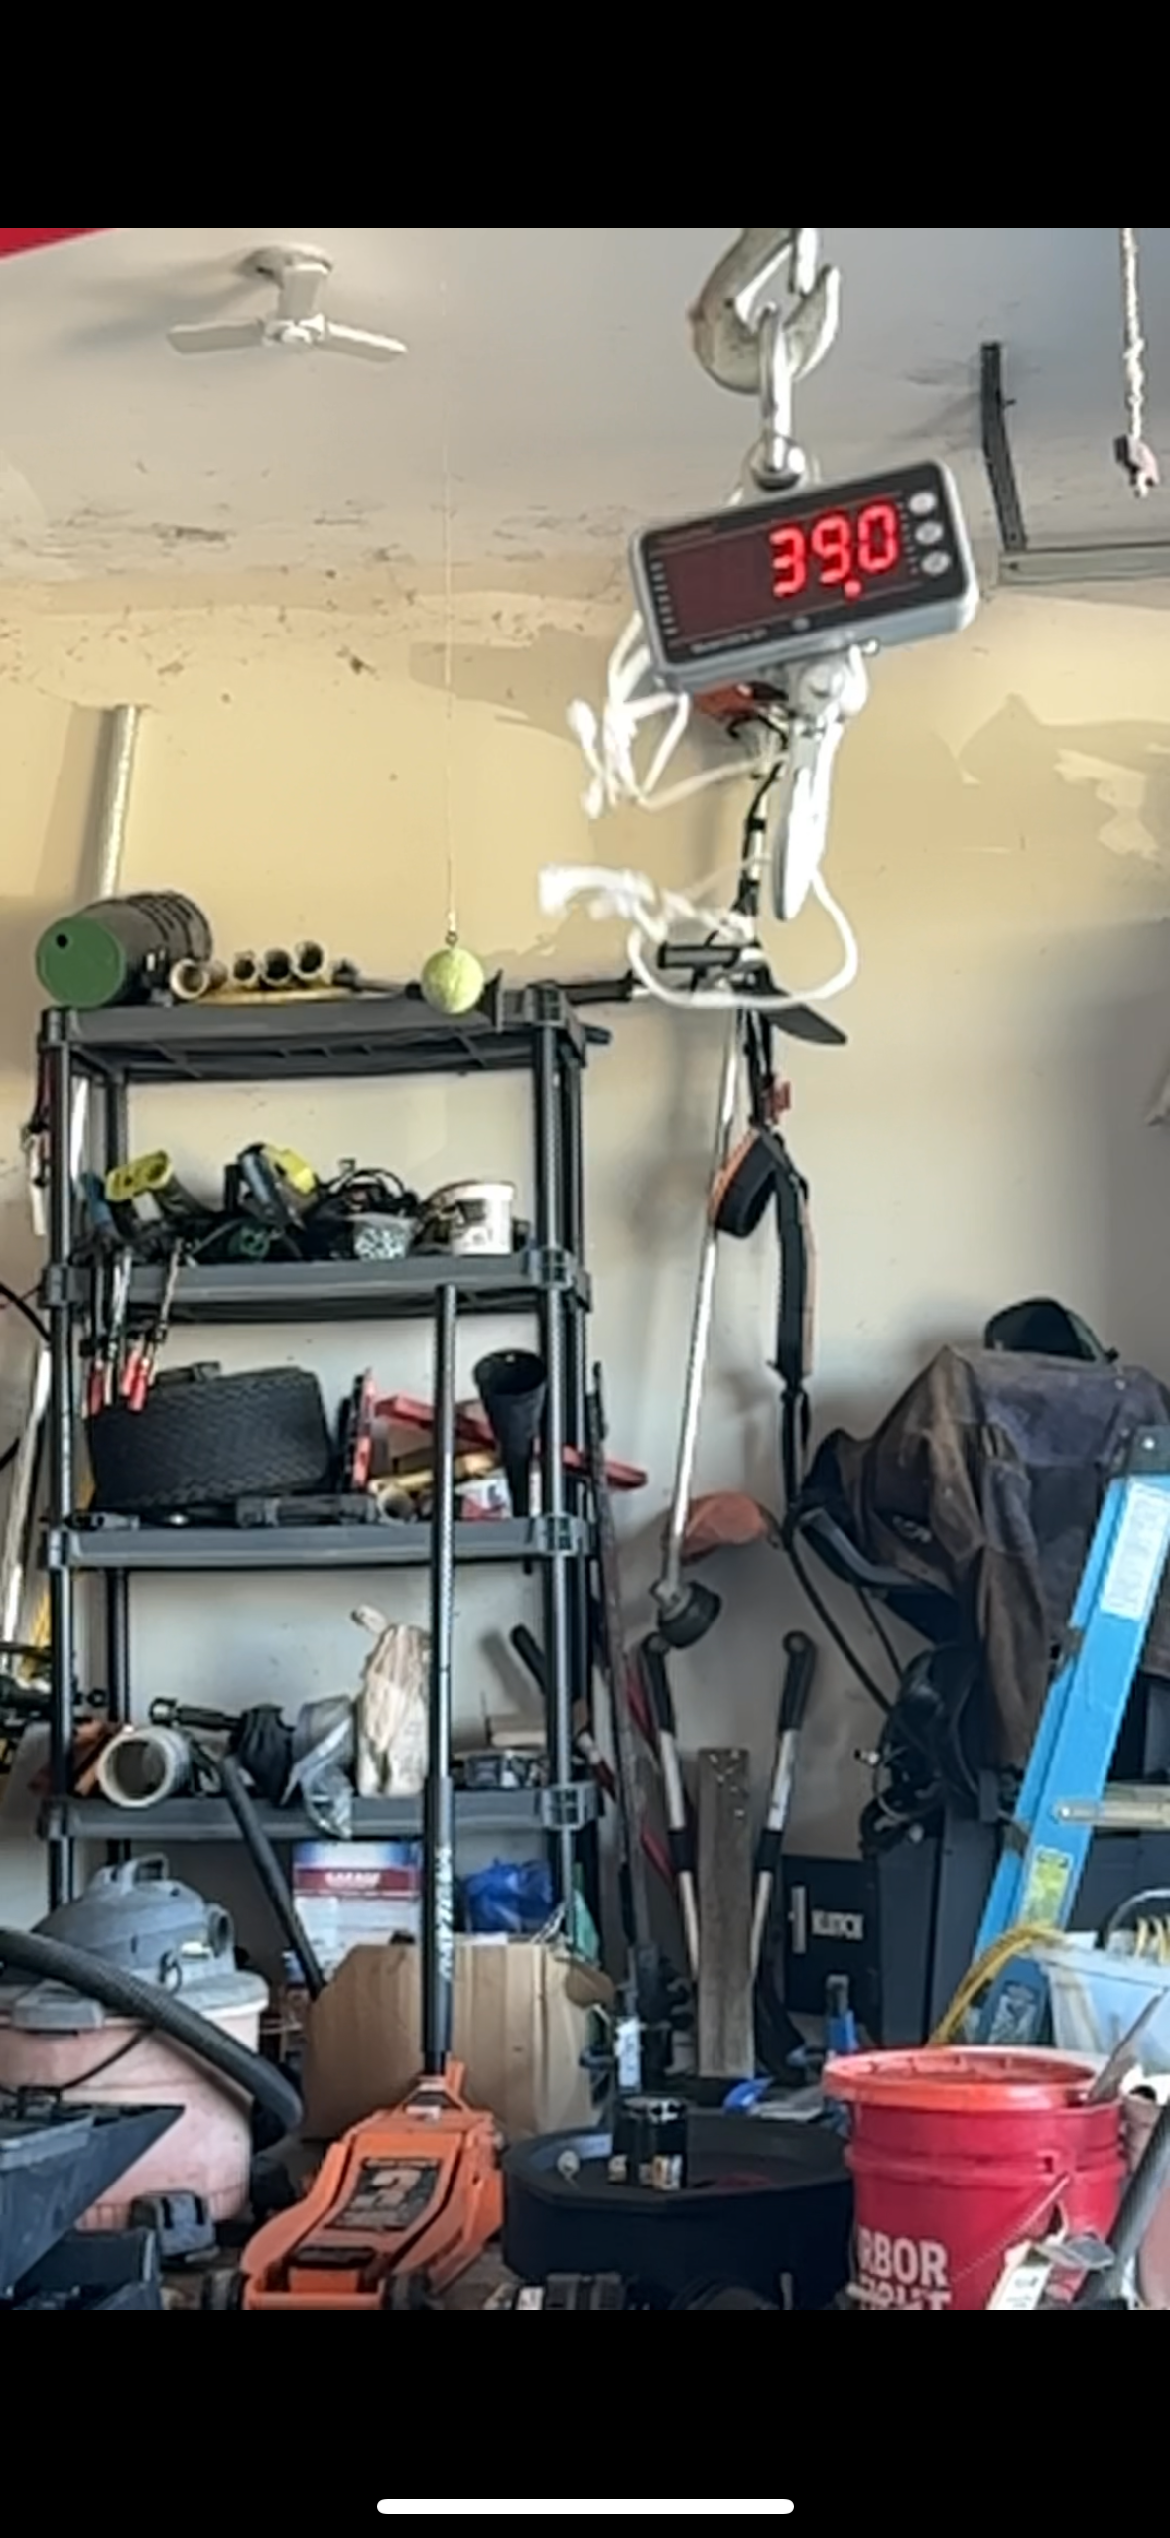
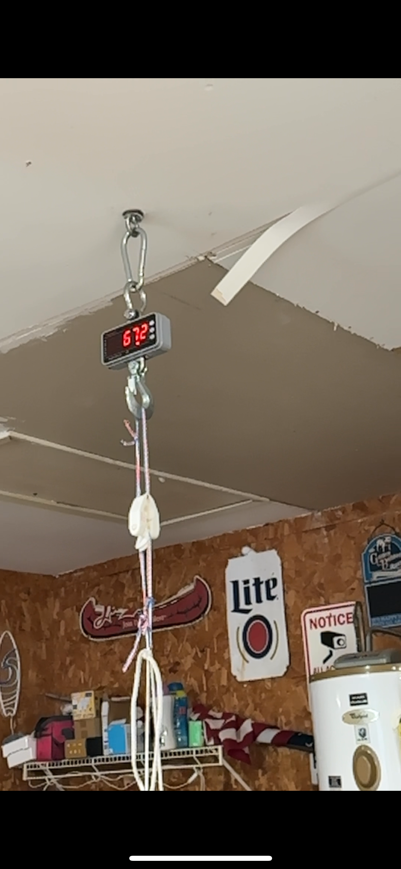
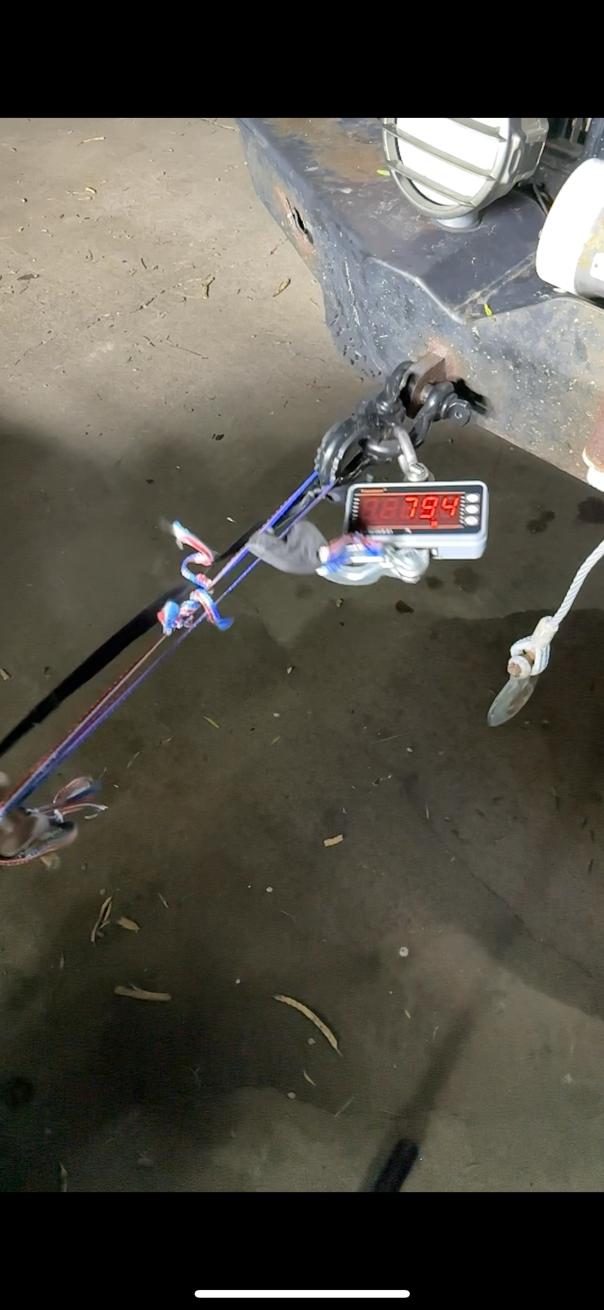
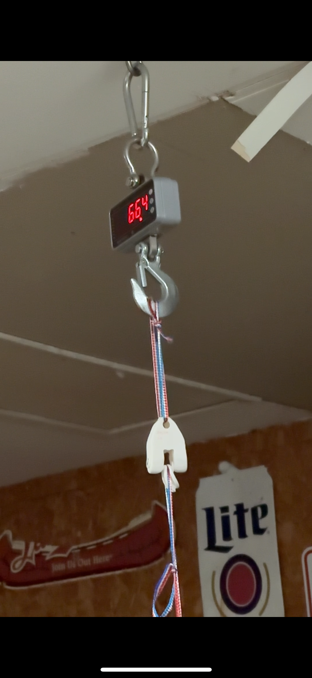
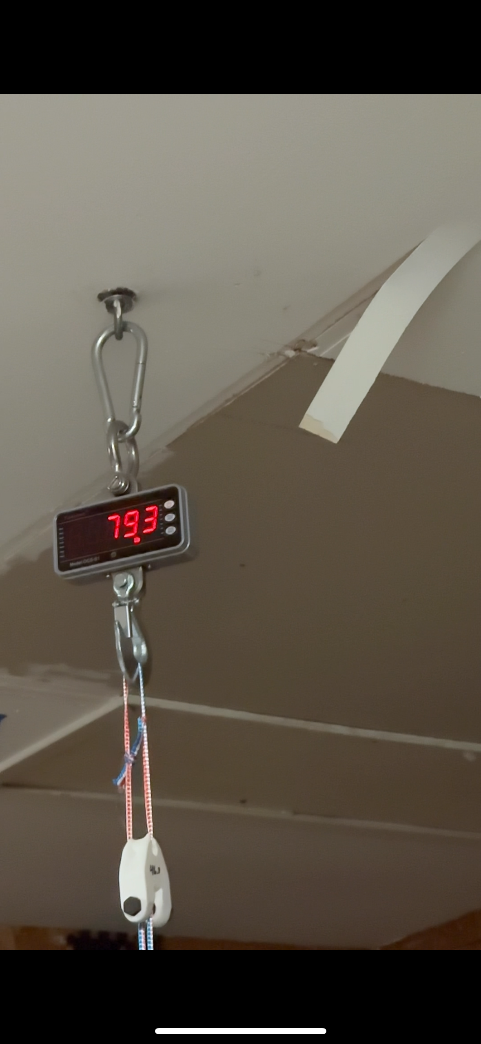
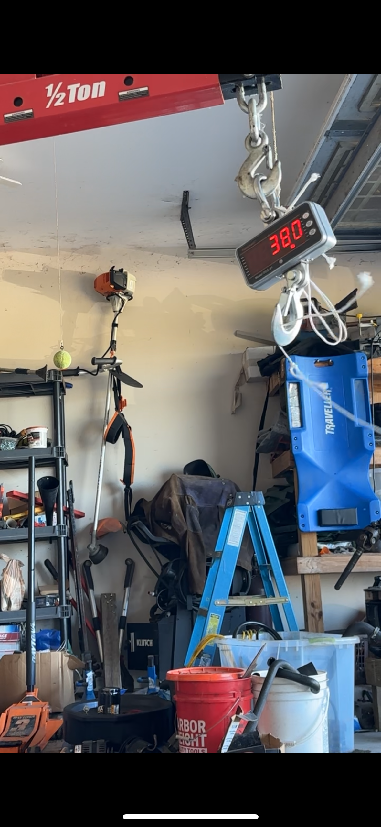
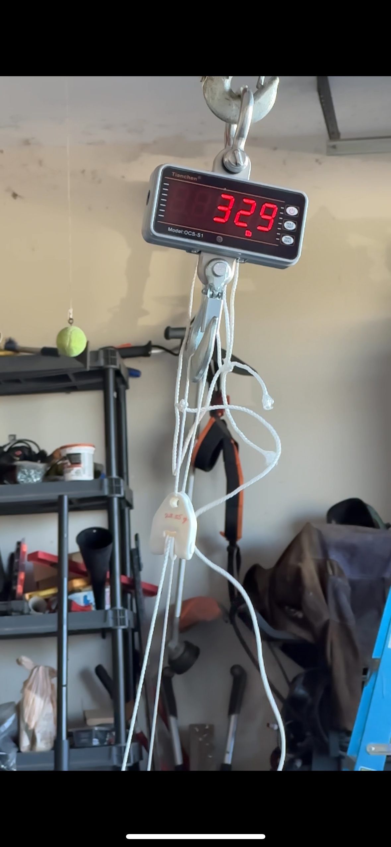
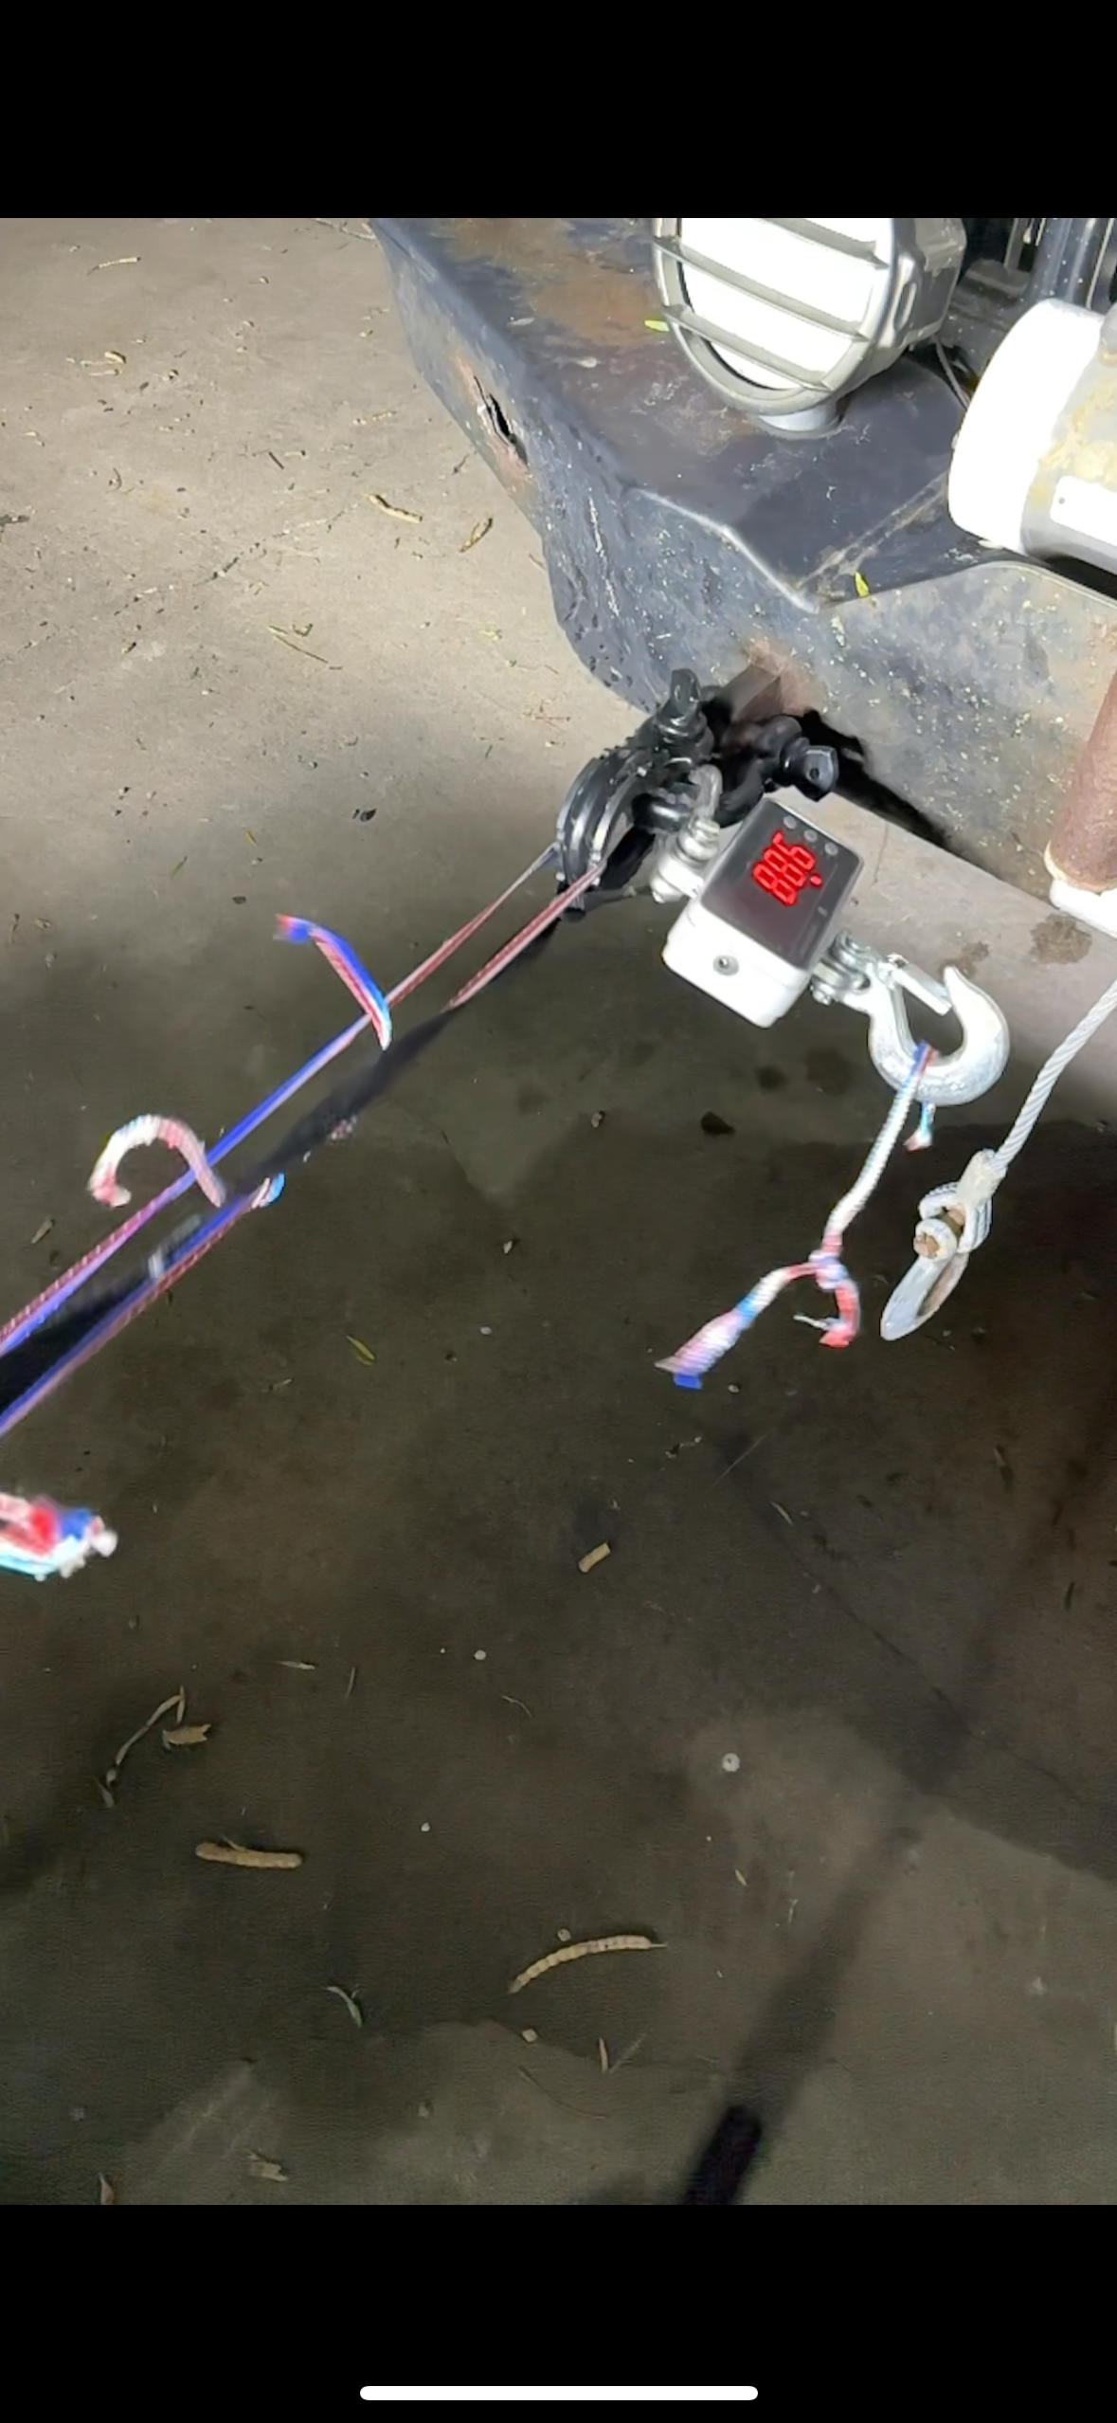
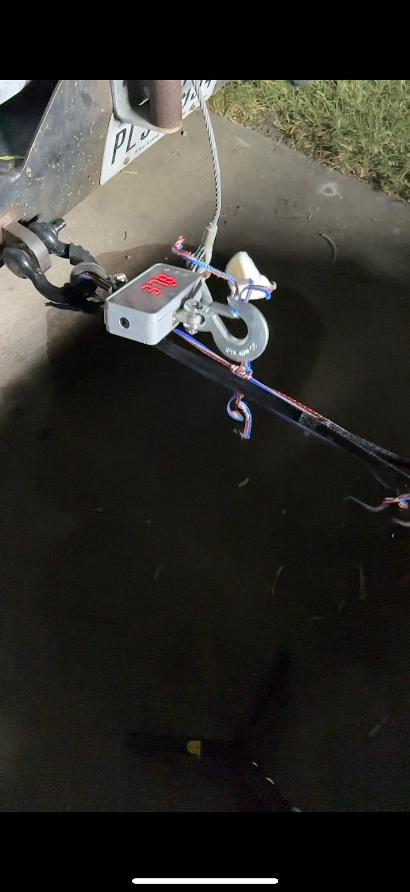

Slide 14
